Slide 1



SOFTWARE DEVELOPMENT PROFESSIONAL PROGRAM
Audio, Video & Iframes

Slide 2





Audio, Video & Iframes
Learning Objectives
Include images, audio, sound effects, and videos on webpages.
Include multiple sources for the same resource.
Add a link to a YouTube video with an iframe.

Slide 3

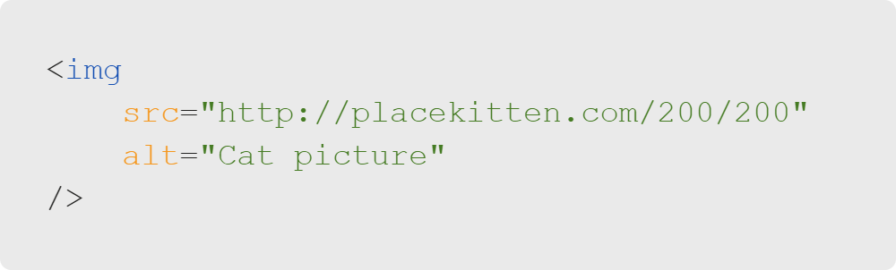
Audio, Video & Iframes
Review: Images
A source for an image is provided via the src attribute.
It can be a path on your computer or a resource from the web.
Notes:
<< Refer to LC exercise 1: Image Paths >>

Slide 4

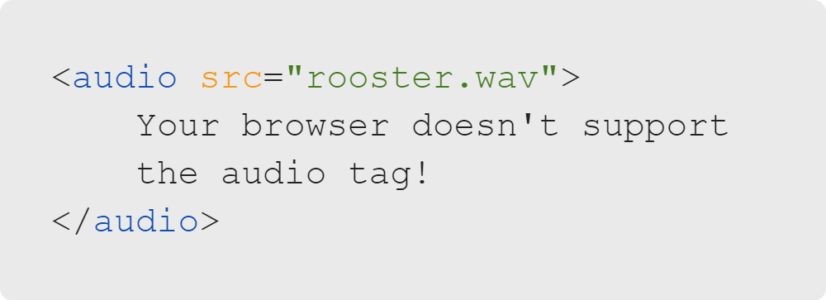
Audio, Video & Iframes
Including Sound
Sound effects and music are provided via the audio tag.
WAV, MP3, and OGG file types are supported.
Notes:
The text will only show up if you have a very old browser that doesn't support HTML5.
<< Refer to LC exercise 2: Audio Paths >>

Slide 5
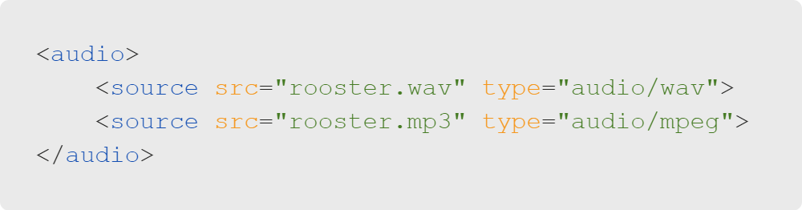
Audio, Video & Iframes
Multiple Sources
Multiple sources can be used for the same resource.
The first supported file type is selected.
Notes:
What we mean by "supported" is that different browsers may support different file types.
For example, Safari doesn't support the OGG file type, but Chrome and Fireforx do.
You can refer to the table here: https://www.w3schools.com/tags/tag_video.asp
<< Refer to LC exercise 3: Multiple Input Sources >>

Slide 6

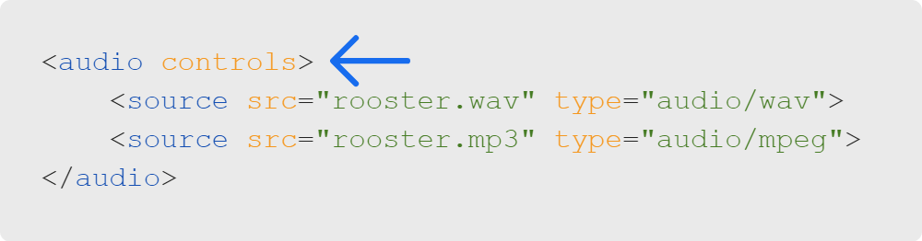

Audio, Video & Iframes
Audio Controls Attribute
Notes:
The controls attribute gives the user a set of control buttons to use.
It comes with a play button and a slider control for volume.

Slide 7
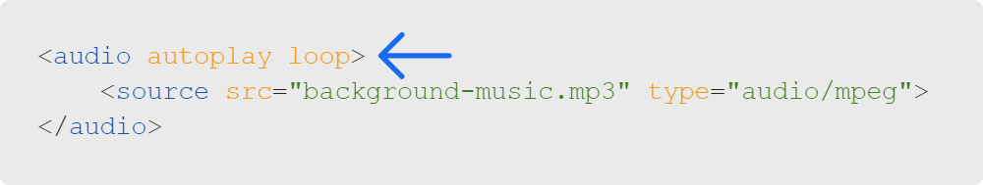
Audio, Video & Iframes
Autoplay and Loop
Loop: Play continuously (start over again when done).
Autoplay: Start playing when the page loads.
Notes:
If we don't want controls, we have the option of playing something automatically after the page loads.
(But be careful; this isn't always supported!)
The loop attribute will simply play the the same audio over and over.

Slide 8
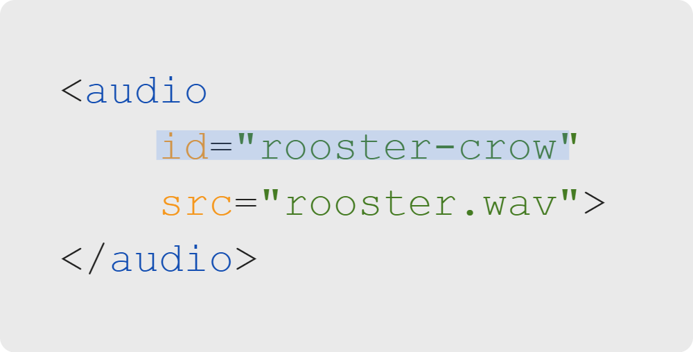

Audio, Video & Iframes
JavaScript API
HTML
JavaScript
Notes:
So what happens if we don't have any controls, loop, or autoplay attributes?
Well, we can control it with JavaScript! Here, we grab it by the ID attribute.

Slide 9
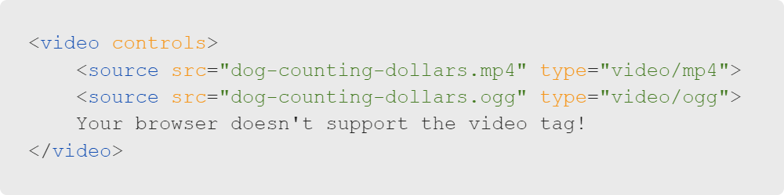
Audio, Video & Iframes
Including Videos
Videos are added with the video tag. MP4, WebM, & OGG files are supported.
Notes:
You may notice that the video and audio tags work similarly.
They both support source tags for multiple sources, as well as
controls, autoplay, and loop attributes.
<< Refer to LC exercise 4: Video Tags >>

Slide 10
Audio, Video & Iframes
YouTube Videos
For including embedded videos, we can use an inline frame or iframe.
Iframes allow you to load content from a secondary site within your page.
Notes:
Think of iframes as pages within pages. Certainly you've seen YouTube videos embedded on other
sites besides YouTube. This is how it's done!

Slide 11

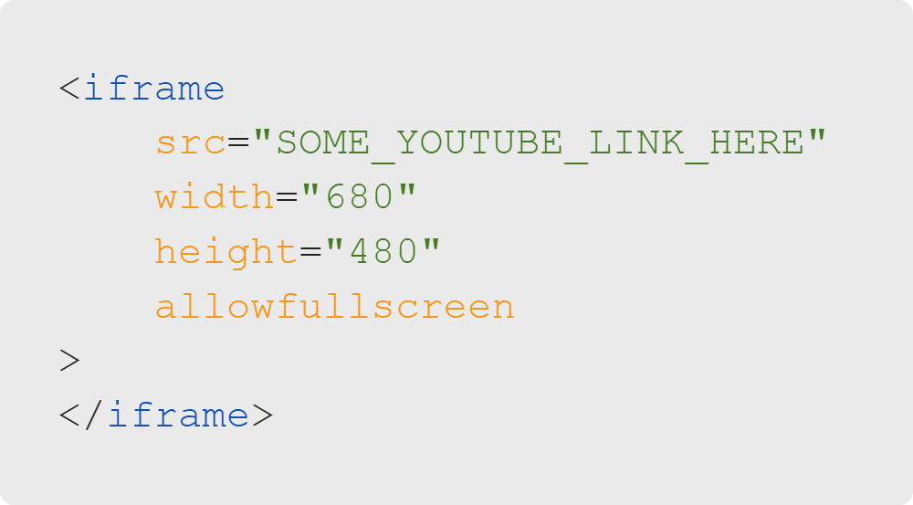
Audio, Video & Iframes
Using Iframes
Content can be included via src.
Width and height can be specified, but they don't change with screen size.
Notes:
Many different types of content can be included with iframes, but we'll focus on YouTube for now
because it's a fun and familiar example.
<< Refer to LC exercise 5: Iframes >>

Slide 12
Audio, Video & Iframes
Embedding with YouTube
YouTube benefits when you play their videos.
They've made it very easy to include their videos.
Notes:
You can click the Share button, then click embed to see the iframe text.

Slide 13
Audio, Video & Iframes
Embedding with YouTube
We can copy the text they provide.
Notice...it's an iframe!

Slide 14

Audio, Video & Iframes
Let's Get into It!
It's fun to talk about media...
But much more fun to use it.
Let's do it!
Notes:
Let's get our hands dirty! We have a lab with some preset resources.

